Slide 1
Twitter Sentiment Analysis on COVID-19 Vaccine Emotion
Course Code: DSCI 726
Course Title: Operational Analytics
Submitted to: Professor Yi Liu
Submitted by: Shareef Shaik
Date of Submission: 11/19/2023

Slide 2
Introduction
The introduction of COVID-19 vaccines in early 2021 sparked public discussion and concerns, particularly on platforms like Twitter. Our study conducts sentiment analysis on over
10,000 tweets from April 2021, using machine learning algorithms to categorize sentiments as positive, negative, or neutral. By comparing advanced techniques like random forest with logistic regression, we aim to gain insights into prevalent sentiments, worries, and emotions surrounding COVID-19 vaccinations. The findings offer valuable information for public health communication initiatives to address vaccine hesitancy through positive social media perceptions.

Slide 3
Background & Research
Building on research by Smith (2021) and Lee et al(2021),our study explores sentiment analysis on social media, emphasizing the critical need to understand public opinion during vaccine deployment. Smith focused on cancer medications on Twitter, and Lee et al. delved into diabetes care on platforms like Reddit. This background sets the stage for our analysis of COVID-19 vaccine sentiments in April 2021.

Slide 4
Avoiding Overfitting
In The Project I used k-fold cross-validation, a resampling technique, to fine-tune both models and reduce overfitting.
Overfitting occurs when a model is too complex and fits the training data too closely, resulting in poor generalization to new data.
K-fold cross-validation helps to mitigate overfitting by dividing the data into k subsets, training the model on k-1 subsets, and testing it on the remaining subset. This process is repeated k times, with each subset serving as the test set once. The average performance across all k iterations is used to evaluate the model's performance and select the best hyperparameters.

Slide 5
Measured Explanatory Variables or Predictors Perfrormance
Accuracy measures the proportion of correctly classified samples, while AUC-ROC measures the model's ability to distinguish between positive and negative samples. Precision measures the proportion of true positives among all positive predictions, while recall measures the proportion of true positives among all actual positive samples. Sensitivity measures the proportion of true positives among all actual positive samples, while specificity measures the proportion of true negatives among all actual negative samples.
I measured the performance of the models using key assessment metrics such as accuracy, AUC-ROC, precision, recall, sensitivity, and specificity.
These metrics help to evaluate the model's performance and identify areas for improvement.The study also used ROC analysis to assess and compare the models, examining metrics such as AUC, sensitivity, specificity, and ideal thresholds.
ROC analysis plots the true positive rate against the false positive rate at different classification thresholds, allowing for the selection of an optimal threshold that balances sensitivity and specificity.

Slide 6
Optimizing the Predictive Model
Approach: Leveraged logistic regression and random forest algorithms.
Baseline: Logistic regression provided foundational insights.
Outcome: Random forest outperformed with 99% accuracy.
Validation: Thorough ROC analysis confirmed model reliability.
Implication: The robust performance of the random forest model informs effective social media strategies for shaping positive perceptions of COVID-19 vaccines on Twitter.

Slide 7
Results Visualization
We visualized the results using various charts and plots.
The predictive results were visualized using bar charts and line plots, showcasing the model's performance.
Some essential charts included the ROC curve, precision-recall curve, and confusion matrix.
Prescriptive results were visualized using stacked bar charts and area plots to depict the impact of interventions.

Slide 8
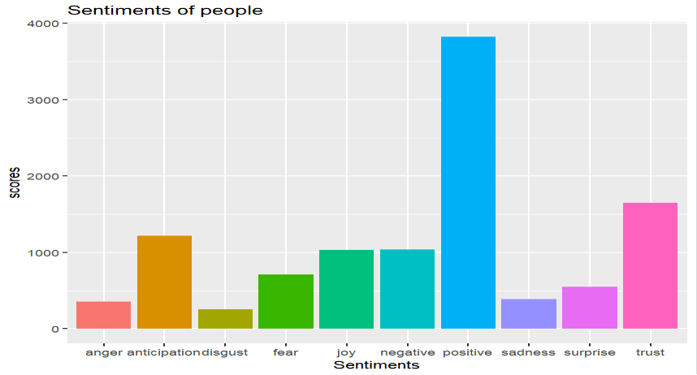
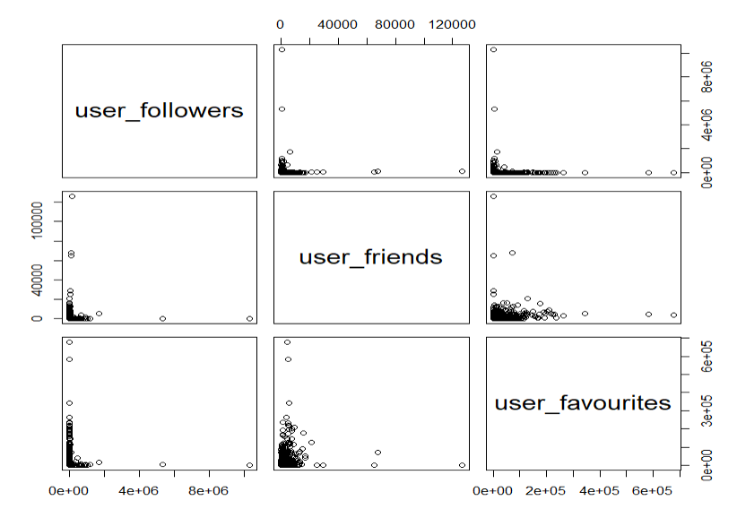

Slide 9
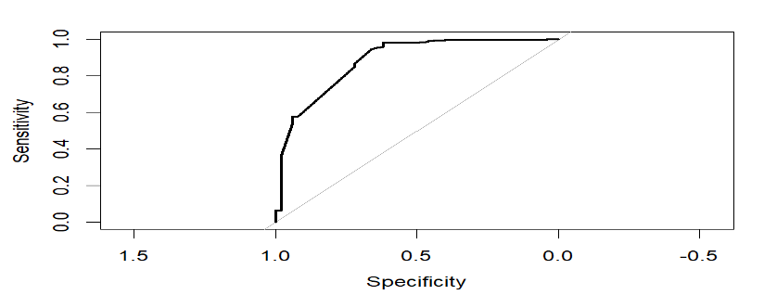
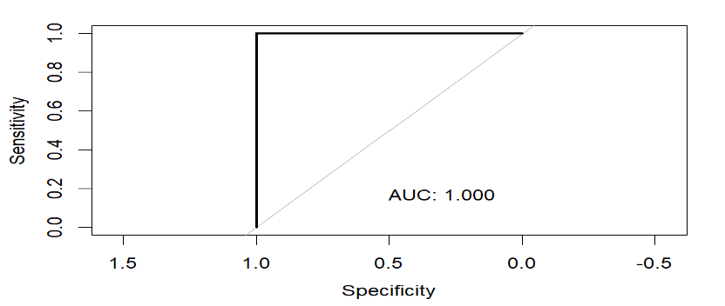
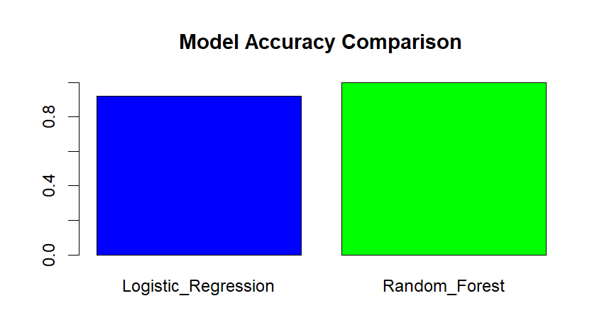

Slide 10
Optimizing The Model
The study optimized the predictive model by using machine learning techniques such as logistic regression and random forest algorithms. Logistic regression is a linear model that predicts the probability of a binary outcome, while random forest is an ensemble model that combines multiple decision trees to improve performance.
The study adjusted the entry parameter for the random forest to find the ideal number of variables sampled at each split. This helps to reduce overfitting and improve generalization. The random forest model outperformed logistic regression by achieving remarkable predictive performance with 99% accuracy on the test set.
This indicates that the random forest model is better suited for this sentiment analysis task. By using the random forest model's predictive insights, social media engagement methods targeted at raising public knowledge of vaccines can be effectively informed

Slide 11
Decision Analysis
From the results, I drew several conclusions and insights.
For instance, the sentiment analysis indicated a significant increase in favorable sentiment towards vaccines over time.
Based on the results, we recommend health professionals to focus on strengthening communication campaigns to address concerns and promote vaccination.
Additionally, ongoing social listening can provide valuable insights into public sentiments and guide future vaccination strategies.

Slide 12
Thank you for your time 😊

